Slide 1
Chatbot-Dialog Management
Business Use-case
Different types of Chatbots
Selecting Domain,intents and entities
Model Training and inference
Dialog or Context management
Attempting to build ai-chatbot

Slide 2
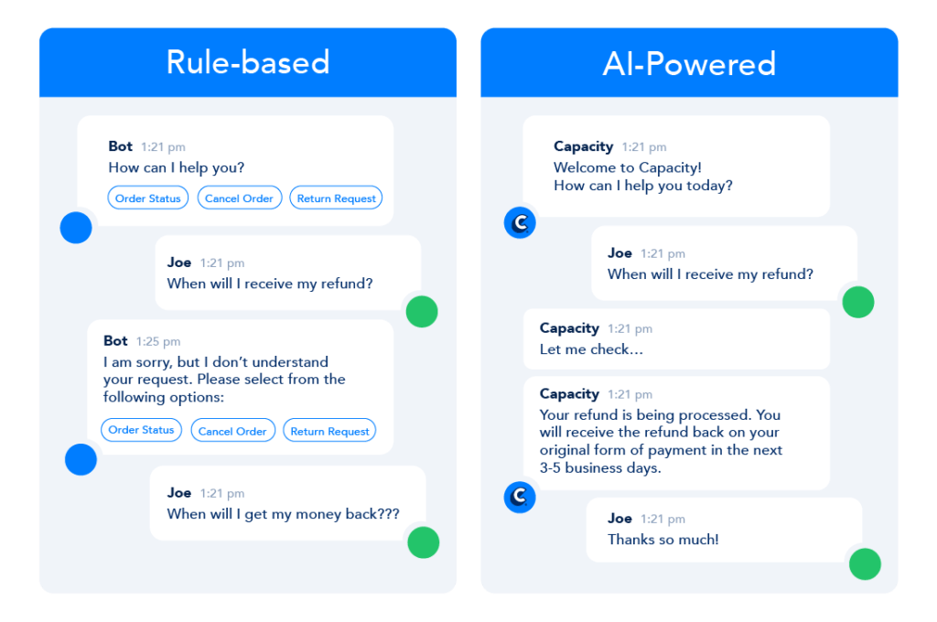
Rule based chatbots vs AI chatbots

Slide 3
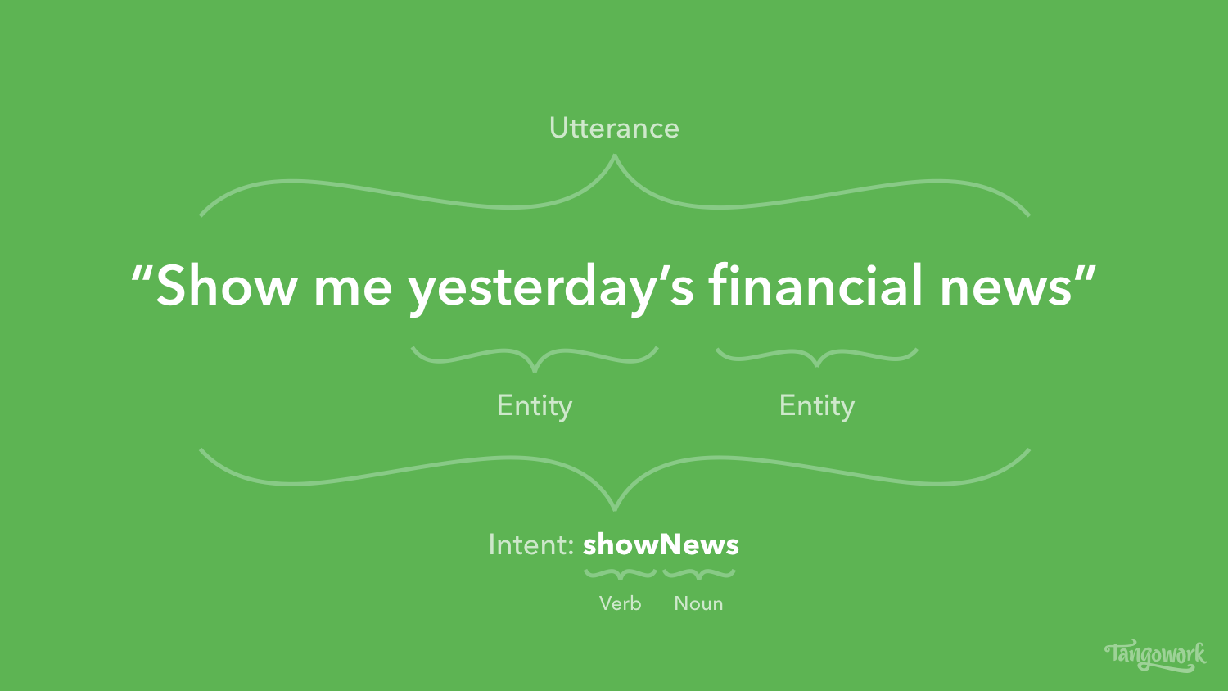
Intents and Entities

Slide 4
Use-Case
Business Use case : E-commerce
Intent : product_info|ask_price|Cancel_order
Entities : product|location|order_id

Slide 5
Data Curation
https://rasahq.github.io/rasa-nlu-trainer/
https://rodrigopivi.github.io/Chatito/

Slide 6
Rasa Demystified
https://rasa.com/docs/
https://rasa.com/docs/rasa/installation/

Slide 7
Mongo DB
https://docs.mongodb.com/manual/tutorial/install-mongodb-on-ubuntu/

Slide 8
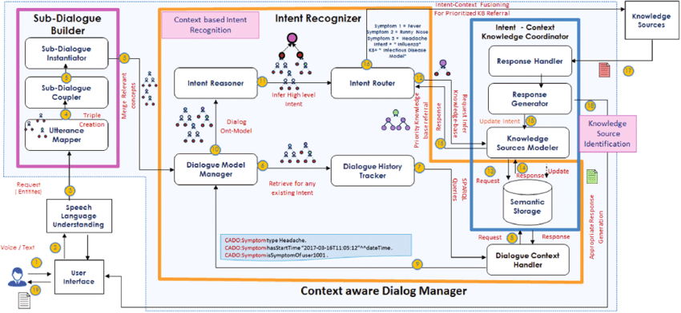
Dialog Manager

